Slide 1
Sales Analysis for an E-Commerce Company

Slide 2

Introduction
The data is taken from kaggle. Its of an E-Commerce company in India.
Business Problem
Which is the best sold product by profit?
Sales v/s Profit by Category.
Quantity v/s Profit by Month.
Orders per Day.
States with the highest Profit.

Slide 3
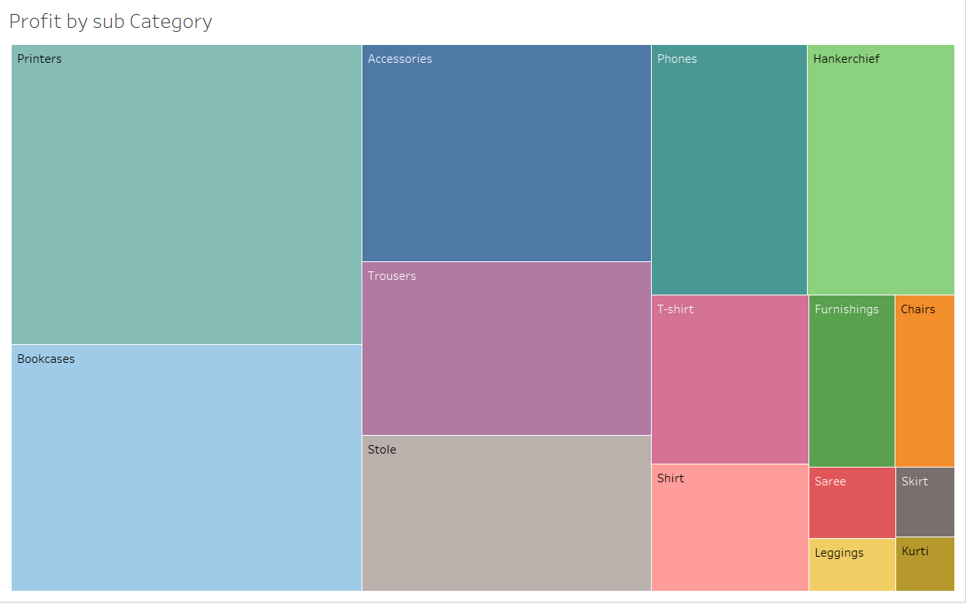
Which is the best sold product by profit ?
The products in Electronics Category like Printers, Accessories and Phones have got more profit as its costly.
With profit of $11,720 over all.
So it would be good in investing more in electronic and having more sub categories and products to have more profit.

Slide 4
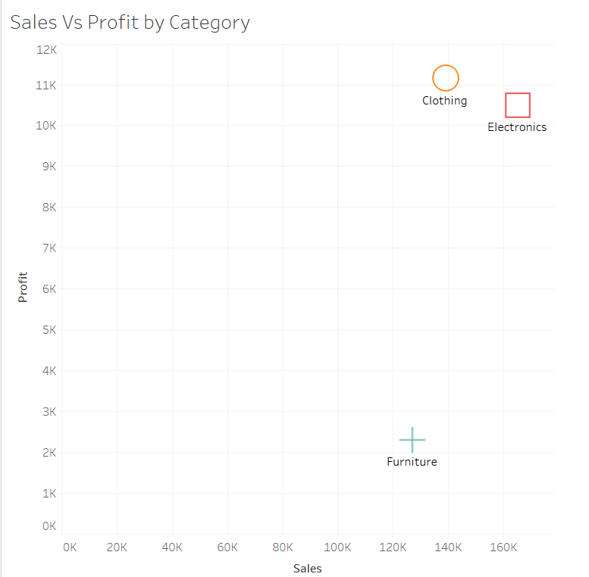
Sales v/s Profit by Category.
The electronic products have high sales but less profit, comparatively Clothing products have less sales with more profit.
The electronic with sales of $165K gives profit of $10K, where as the clothing products with sales of $139K gives profit of $11K.
So it would be good by putting more varieties of electronic products and Manufacturing more clothing products.

Slide 5
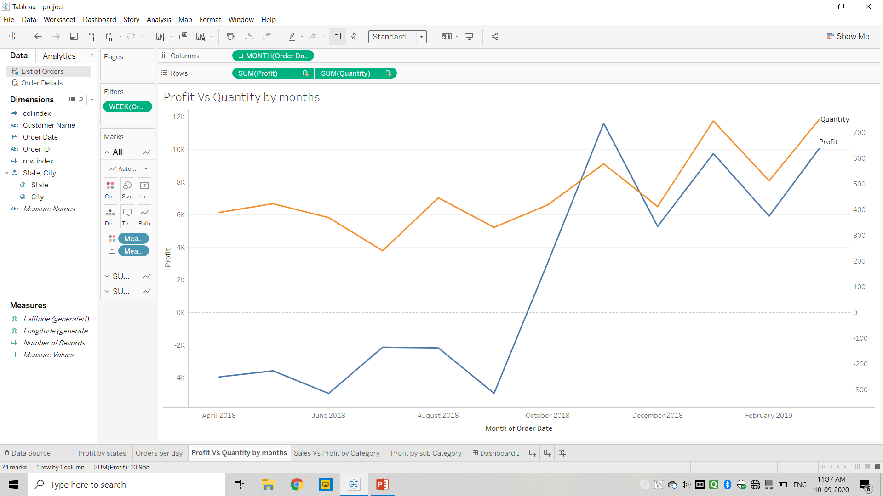
Quantity v/s Profit by Month.
The sales got hike between October 2018 to December 2018 during which its festival time in India and the clothing sales was recorded most with sales of $13K and profit of $3K+.
In festival time clothing is the best selling category and we can work on more designs and traditional wears in festival time.

Slide 6
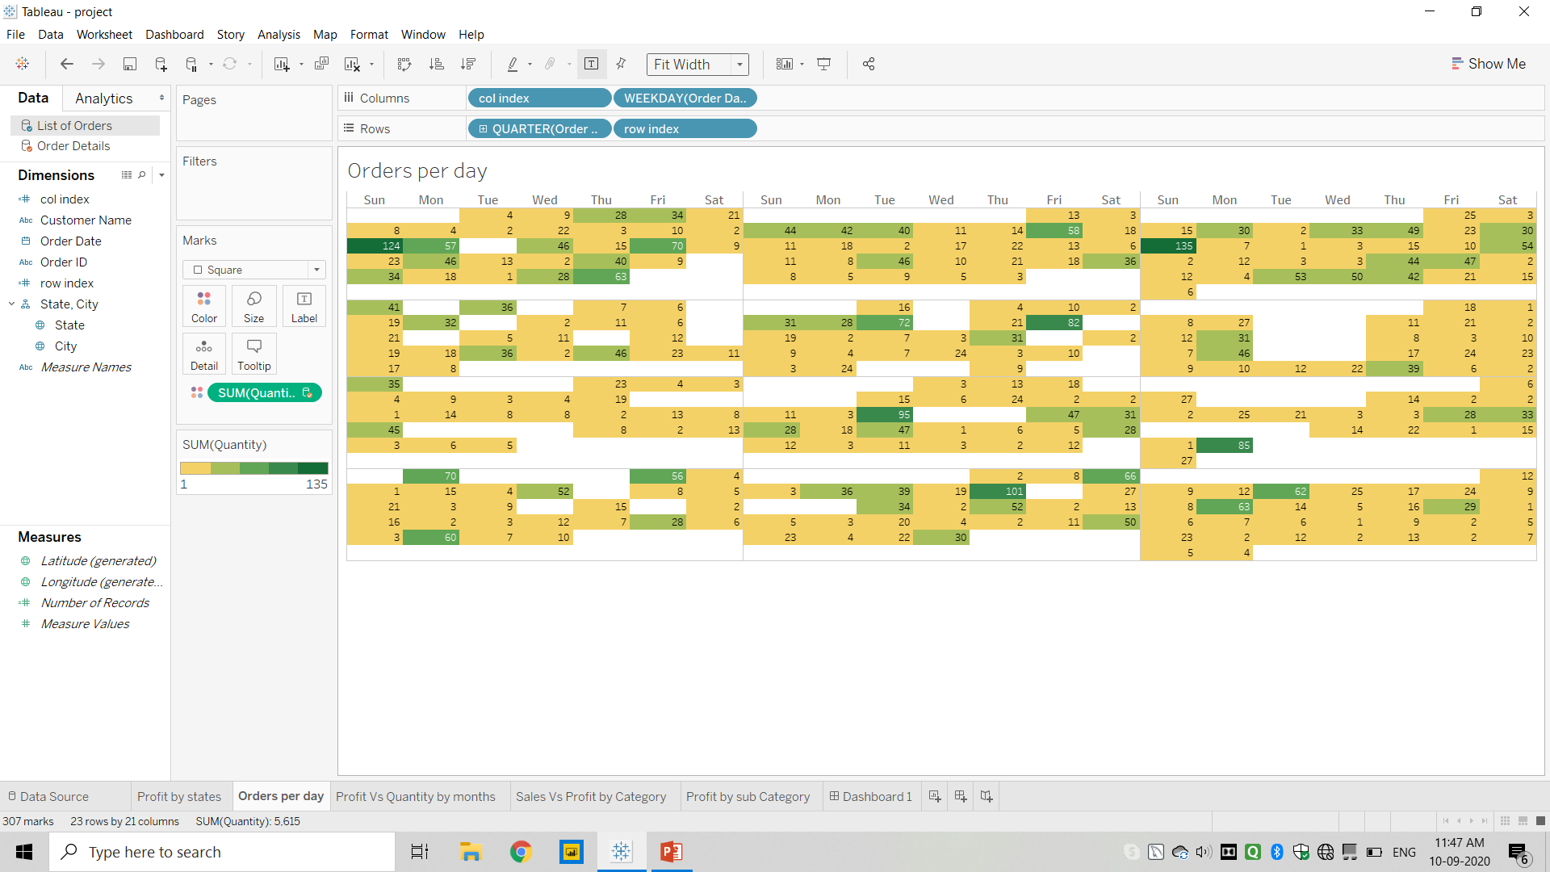
Orders per Day.
In India people only shop when they have time or when it some occasions and festivals. As the orders placed are mostly on Sundays and the days when it was holidays.
We can have shopping mania where we give them discounts for particular period of time.

Slide 7
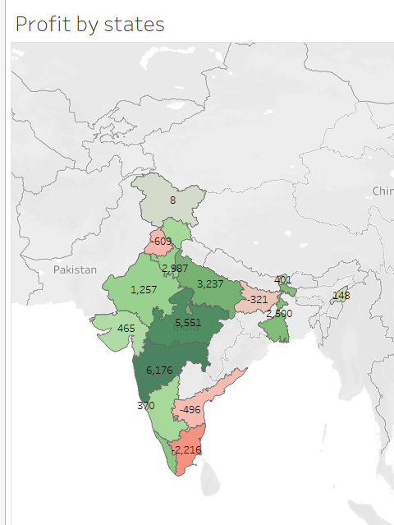
States with the highest Profit.
The state which gave the highest profit is Maharashtra and Madhya Pradesh with profit of $6K and $5.5K respectively.
As Maharashtra has Mumbai the Business city the most sales were here of Electronics and Clothing.
The Sales depends on the location, as of what people needs most in that area will raise the sales of that particular region.

Slide 8
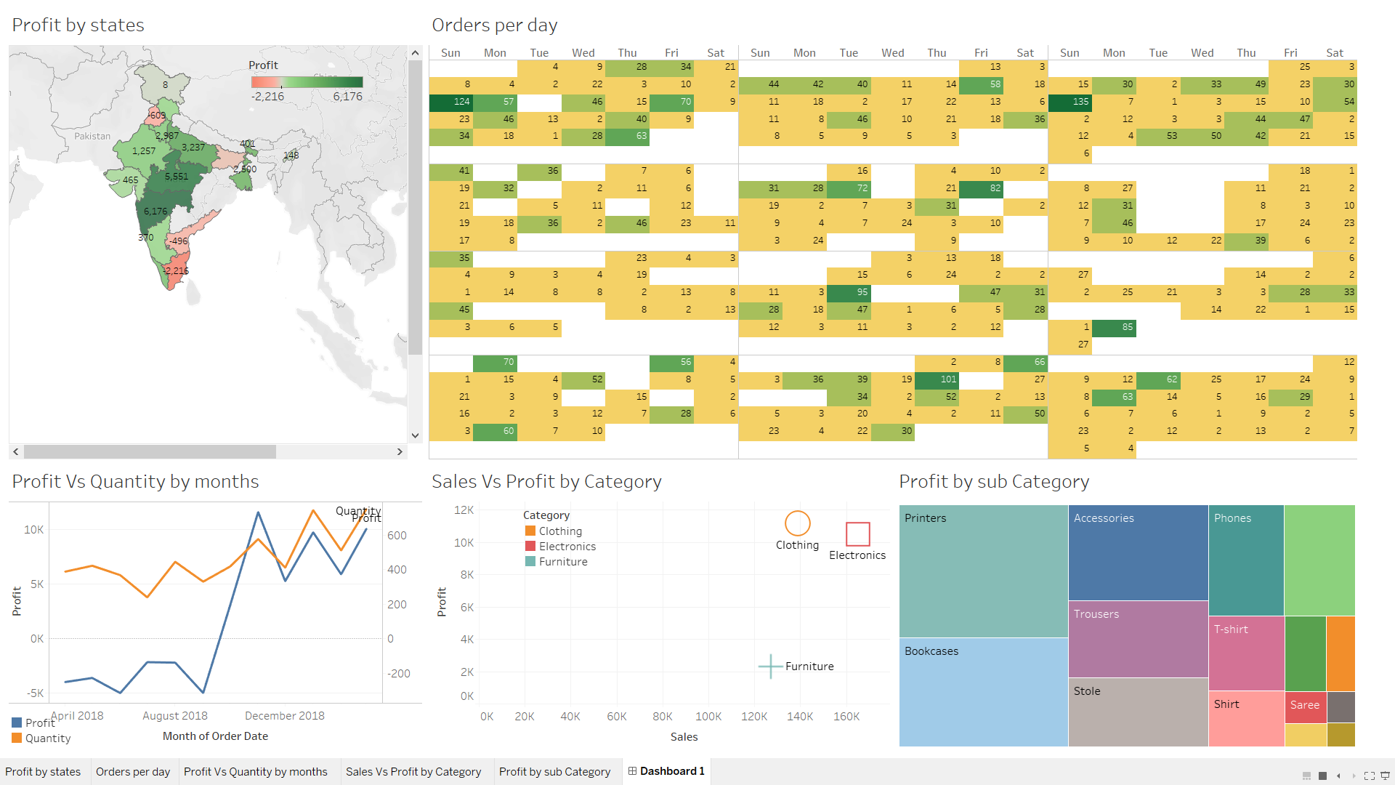
Dashboard

Slide 9
conclusion
Overall analysis states the following conclusions:
The electronics products are costly and increase the sales but not profit as compare to clothing products as they are not that costly and less making cost which gives more profit.
In India, People shop mostly on weekends and on the days of holidays.
During the festivals, Clothing category has the highest sales and Profit.
More business related states buy more electronics.

Slide 10
THANK YOU

